Slide 1
PREDICT CREDIT CARD ACCEPTANCE
Project Mentor:
PROF. ARNAB CHAKRABORTY
Team Members:
Sarada Sudarshan
Vansh Talreja
Yashas Rao

Slide 2
CONTENTS
Project Objective & Scope
Data Description
Methodology
Data Preprocessing
Models
Accuracy Comparison
Future Scope of Improvements

Slide 3
PROJECT OBJECTIVE & SCOPE
OBJECTIVE
Given: A small credit card dataset for simple econometric analysis, taken originally from William Greene's book of Econometric Analysis.
Goal: To predict whether a credit card application will be accepted based upon various data about the applicant.
SCOPE
This project is to determine whether the new applicants are likely to receive the credit card or not. Out of the 4 algorithms used here, finding the optimum algorithm for this credit card data.

Slide 4
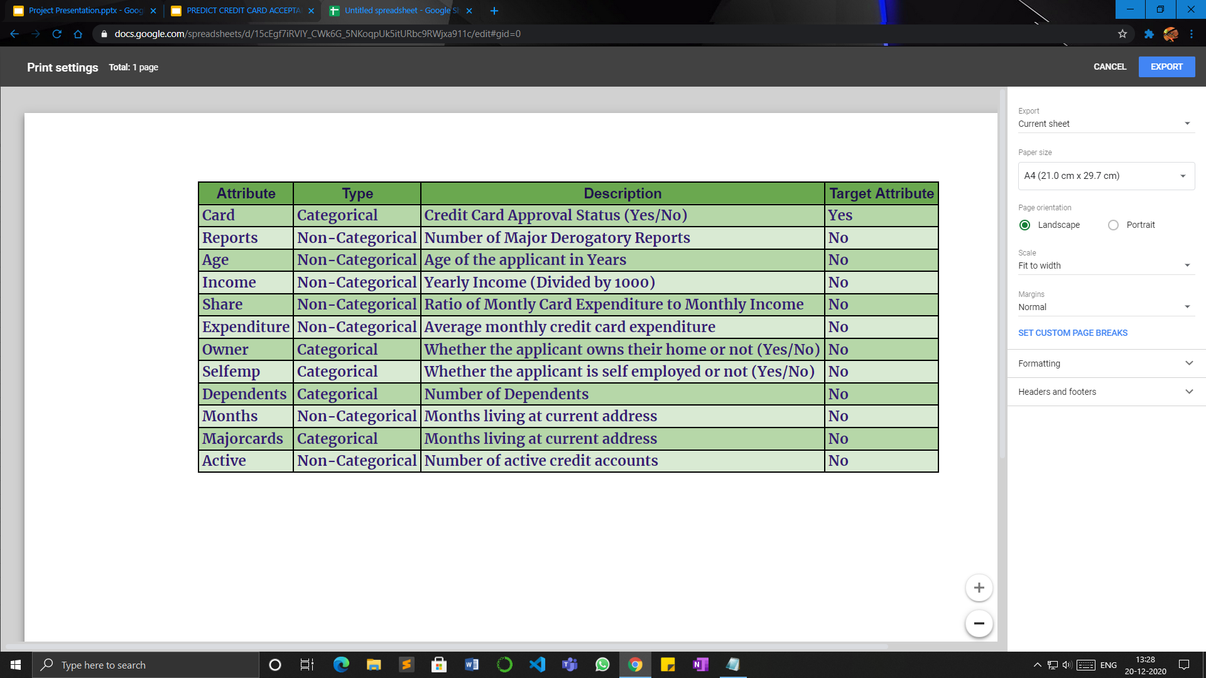
DATA DESCRIPTION
DESCRIPTION

Slide 5
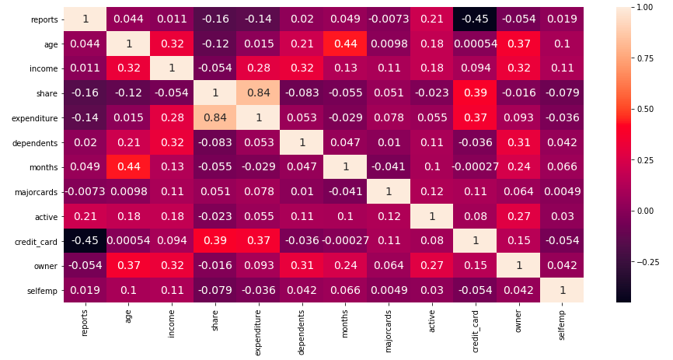
Heatmap

Slide 6
METHODOLOGY
Data Acquisition
1
Exploratory Data Analysis
[EDA]
2
Data Preprocessing
3
Modelling.
4
Model Comparison
5

Slide 7
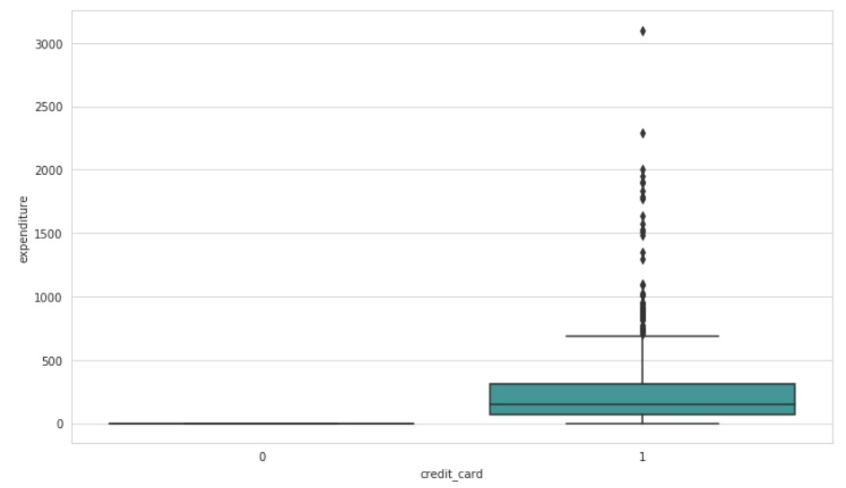
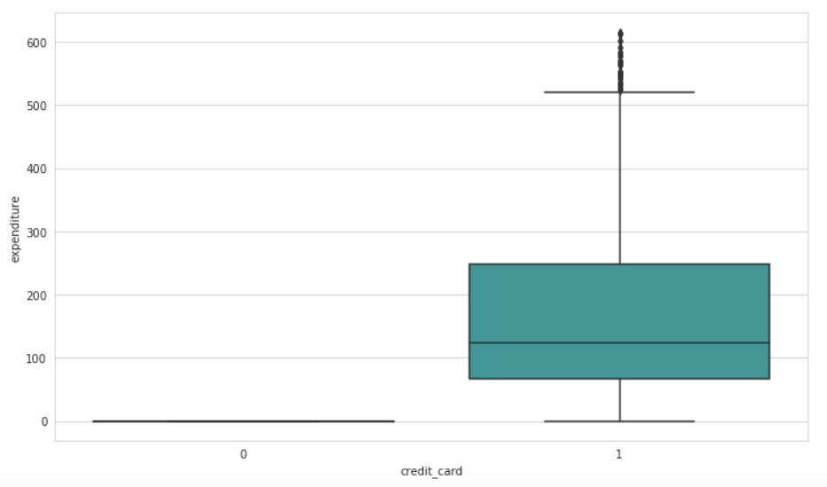
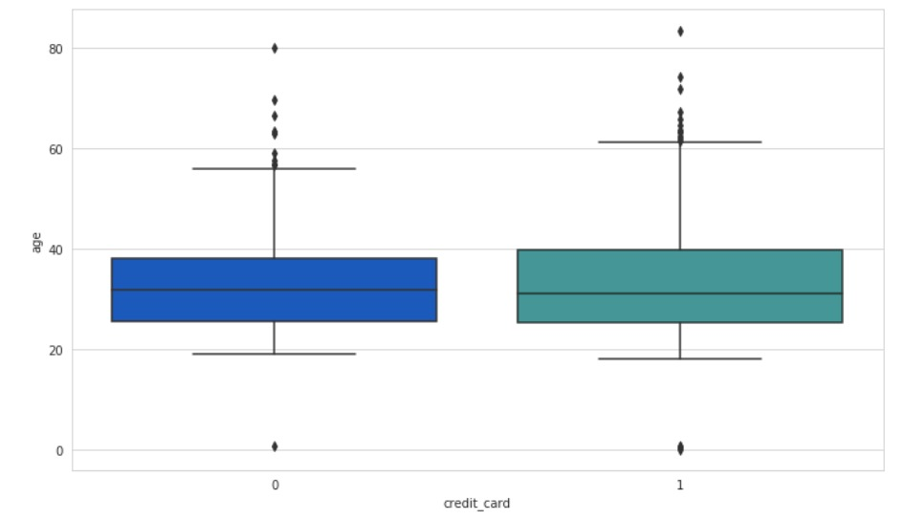
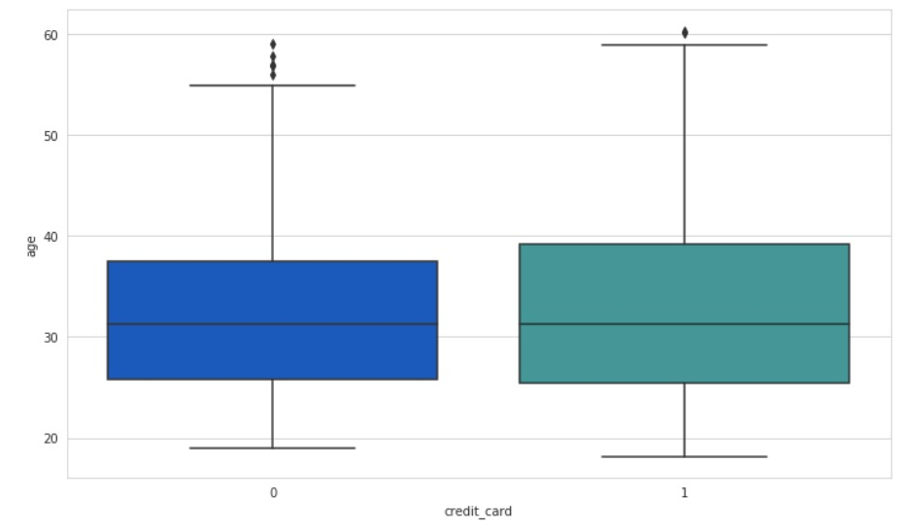
DATA PREPROCESSING
EXP
A
G
E
The Outliers have been replaced by Median

Slide 8
MODELS USED
LINEAR REGRESSION
DECISION TREE
NAIVE BAYES
K-NN

Slide 9
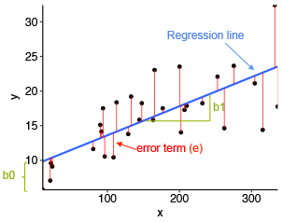
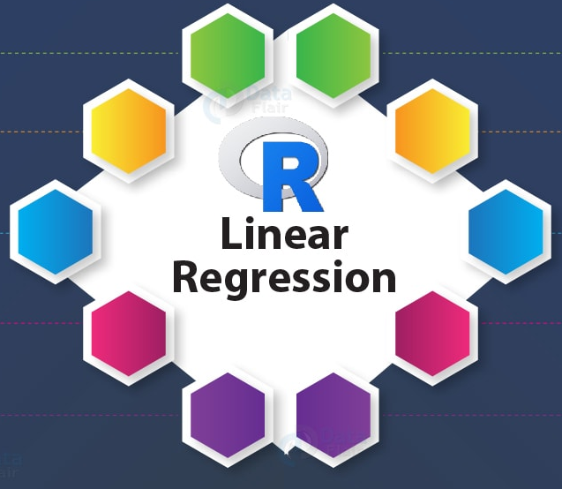
LINEAR REGRESSION
Linear regression is a linear approach to modelling the relationship between a scalar response and one or more explanatory variables.

Slide 10
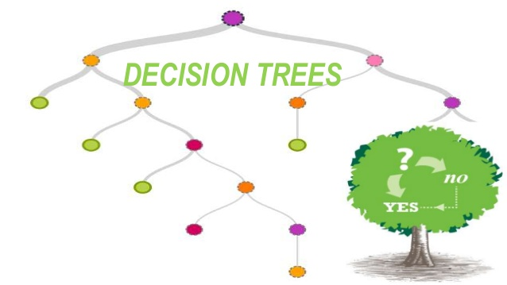
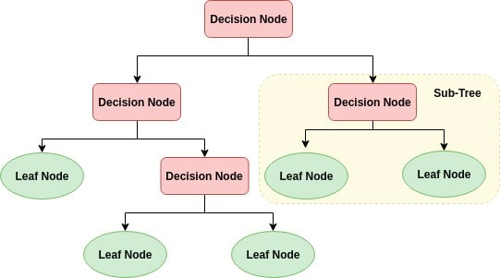
DECISION TREE
A decision tree is a decision support tool that uses a tree-like model of decisions and their possible consequences.

Slide 11

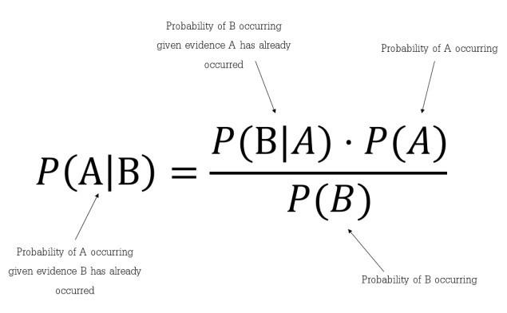
NAIVE BAYES
Naive Bayes classifiers are a family of simple ‘probabilistic classifiers’ based on applying Bayes' theorem with strong independence assumptions between the features

Slide 12
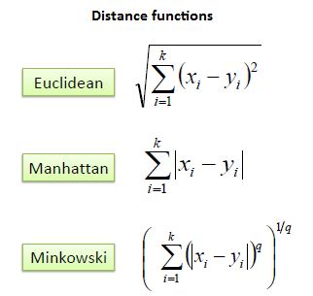
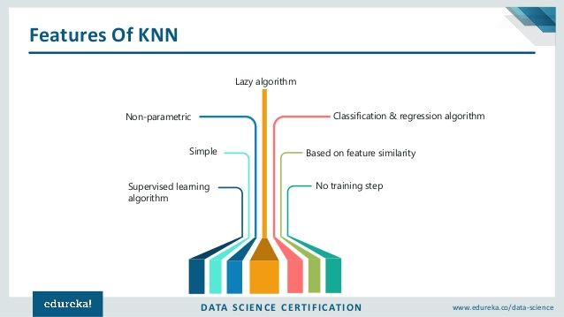
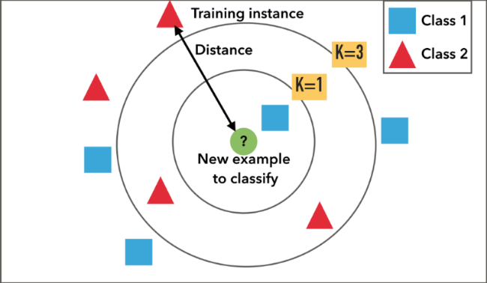
K-NN
The K-nearest-neighbor algorithm is an approach to data classification that estimates how likely a data point is to be a member of one group or the other depending on what group the data points nearest to it are in.

Slide 13
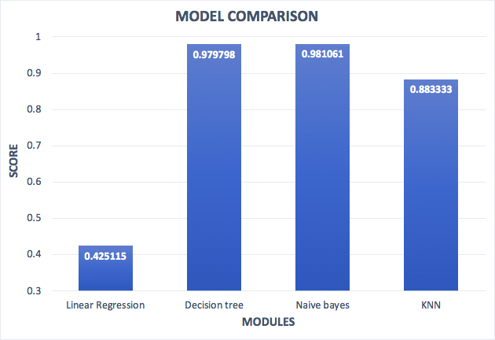
MODEL COMPARISON
MODULES | ACCURACY
Linear Regression | 0.425115
Decision Tree | 0.979798
Naive Bayes | 0.981061
KNN | 0.883333
Best Model - Naive Bayes

Slide 14
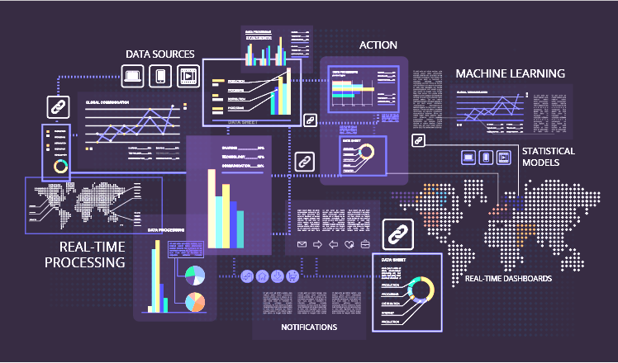

FUTURE SCOPE OF IMPROVEMENTS
Customers intending to apply for credit card can use these trained models to check whether their application will be approved or not.
Developing a UI for the users to check if their application will be accepted or not more comfortably.
Making the model more efficient by providing more data and training to the model.
Implementing the same code in an app or website.

Slide 15
THANK YOU

